Slide 1

Machine Learning
"Advancing Real Estate Analytics: A Machine Learning Approach for Price
Prediction and Personalized Recommendations"
Tipu Sultan
Fordham University, New York, USA
(Email: tsultan1@fordham.edu)

Slide 2

Overview
Introduction
Data Collection
Data Cleaning
Feature Engineering
EDA and Outlier Detection
missing value imputation
Feature Selection Model Selection
Building Analysis Module
Building Recommendation System
Implemntation in the web
Video presentation

Slide 3
Introduction
Significance in Real Estate Analytics:
This project addresses the pressing need for accurate property Price and personalized recommendations.
Key Points:
Real-world Impact: Our project is not just an exploration but a practical solution aimed at enhancing real estate analytics in a rapidly evolving market.
Dataset Source: We extract and clean data from the prominent real estate platform, https://www.99acres.com/.
Innovative Methodology: Comprehensive data analysis, feature engineering, and diverse machine learning models are employed for accurate price predictions and personalized recommendations.
User Engagement: The integration of a recommendation system, driven by TFIDF Vectorizer, adds an extra layer of user-centric functionality.
Practical Applicability: The successful deployment of the entire project into a user-friendly website underscores the practical applicability of our approach.

Slide 4
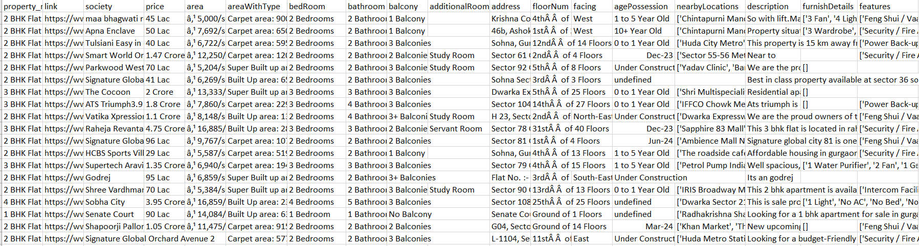
Dataset

Slide 5

Data Collection
Dataset Features
99acres Dataset: Rich & Diverse Information for Model Training
Capturing Nuances: Comprehensive Data for Influential Factors
Key Points:
Diversity:
Encompasses Various Property Types, Locations, and Features
2.Real-world Relevance:
Mirrors Real-world Real Estate Scenarios
3.Accurate Training:
Large and Varied Dataset Enhances Model Generalization
4.Challenges and Opportunities:
Overcoming Missing Values, Uncovering Patterns, and Trends

Slide 6

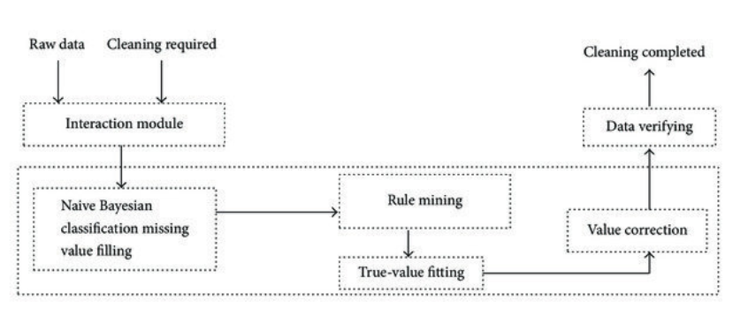
Data Cleaning
Missing Data Handling
Imputation Using ML Techniques
Ensuring Data Integrity
Verification and Validation
for Meaningful Analysis

Slide 7
EDA (Exploratory Data Analysis)
Three-Way EDA:
Our Exploratory Data Analysis (EDA) is a comprehensive three-step process, crucial for understanding the nuances of the dataset and extracting valuable insights.
1. Univariate Analysis:
Objective: To understand the distribution of individual variables in isolation.
Techniques:
Descriptive statistics, histograms, and boxplots.
Insights Gained:
Unveiled the spread and central tendency of individual features.

Slide 8
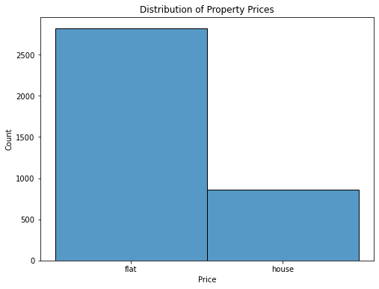
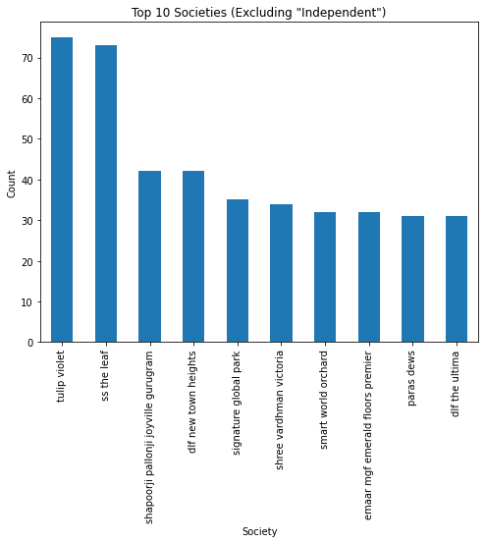
Univariate Analysis

Slide 9
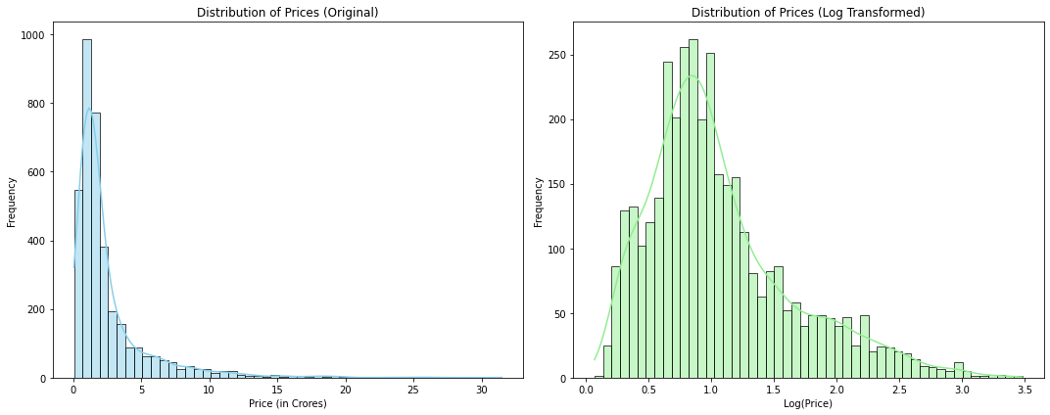
Univariate Analysis

Slide 10
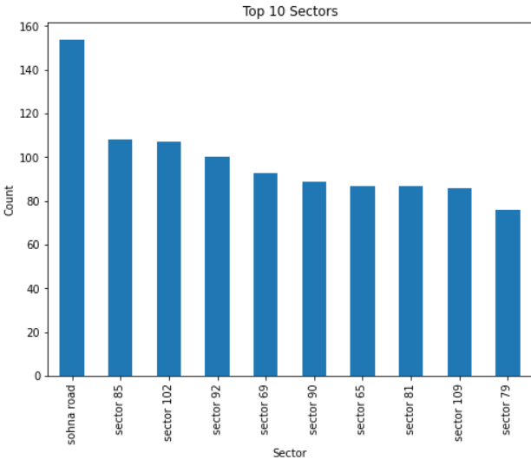
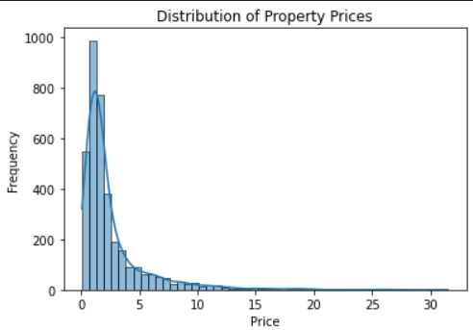
Univariate Analysis

Slide 11
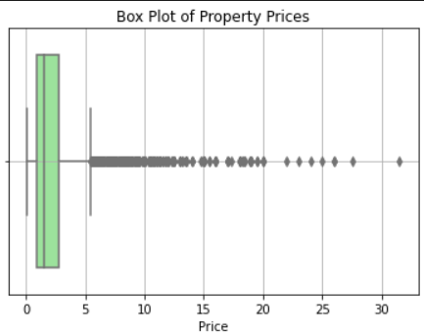
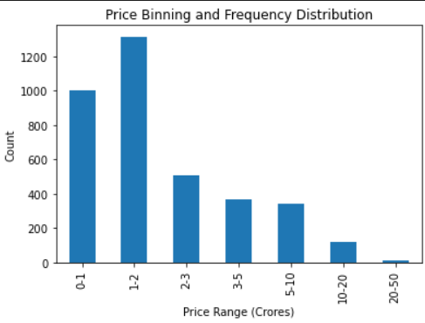
Univariate Analysis

Slide 12
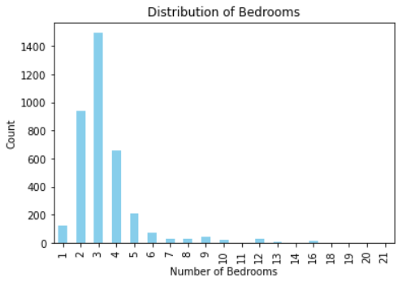
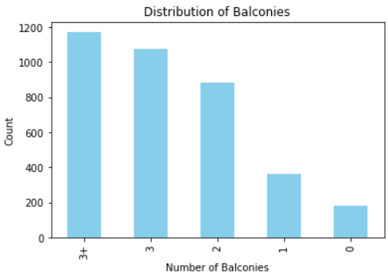
Univariate Analysis

Slide 13
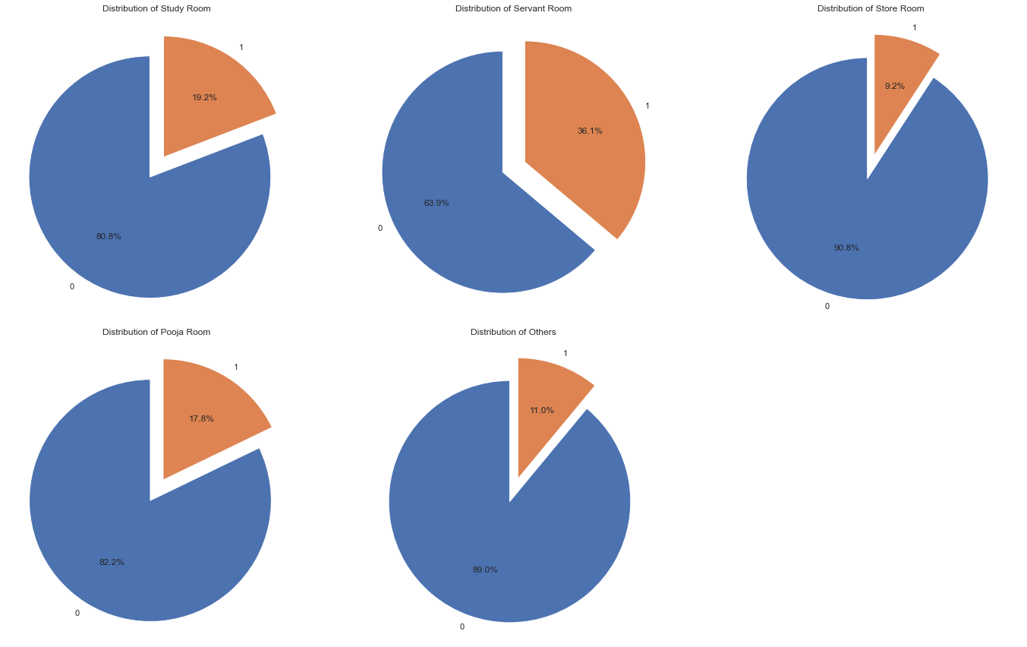
Univariate Analysis

Slide 14
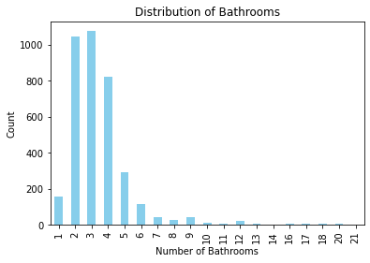
Univariate Analysis

Slide 15
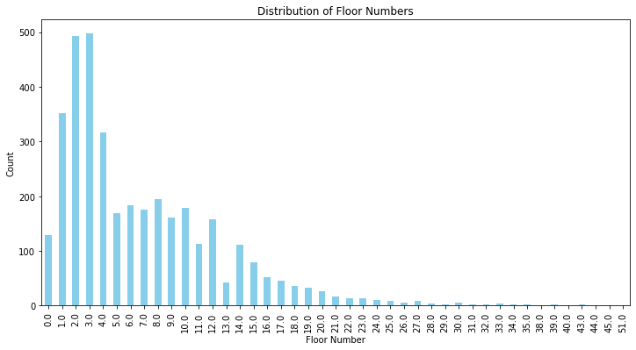
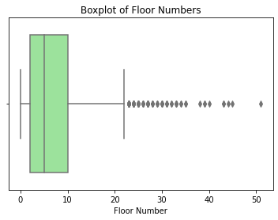
Univariate Analysis

Slide 16
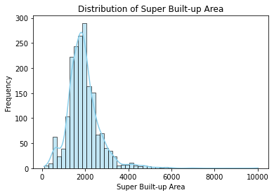
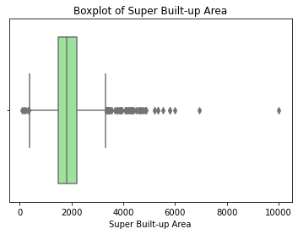
Univariate Analysis

Slide 17
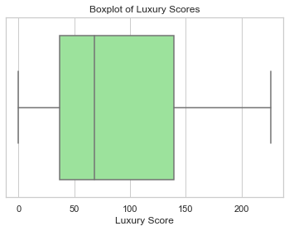
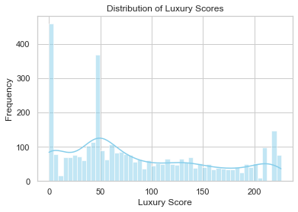
Univariate Analysis

Slide 18
Pandas Profiling:
2. Pandas Profiling:
Objective: A holistic overview of the dataset's structure and characteristics.
Techniques:
Leveraged the Pandas Profiling library for detailed statistical summaries.
Insights Gained:
Uncovered correlations, missing data patterns, and statistical measures for each variable.

Slide 19
Multivariate Analysis
3. Multivariate Analysis:
Objective: To examine relationships between multiple variables simultaneously.
Techniques:
Correlation matrices, scatter plots, and heatmaps.
Insights Gained:
Discovered patterns, dependencies, and potential outliers within the dataset.

Slide 20
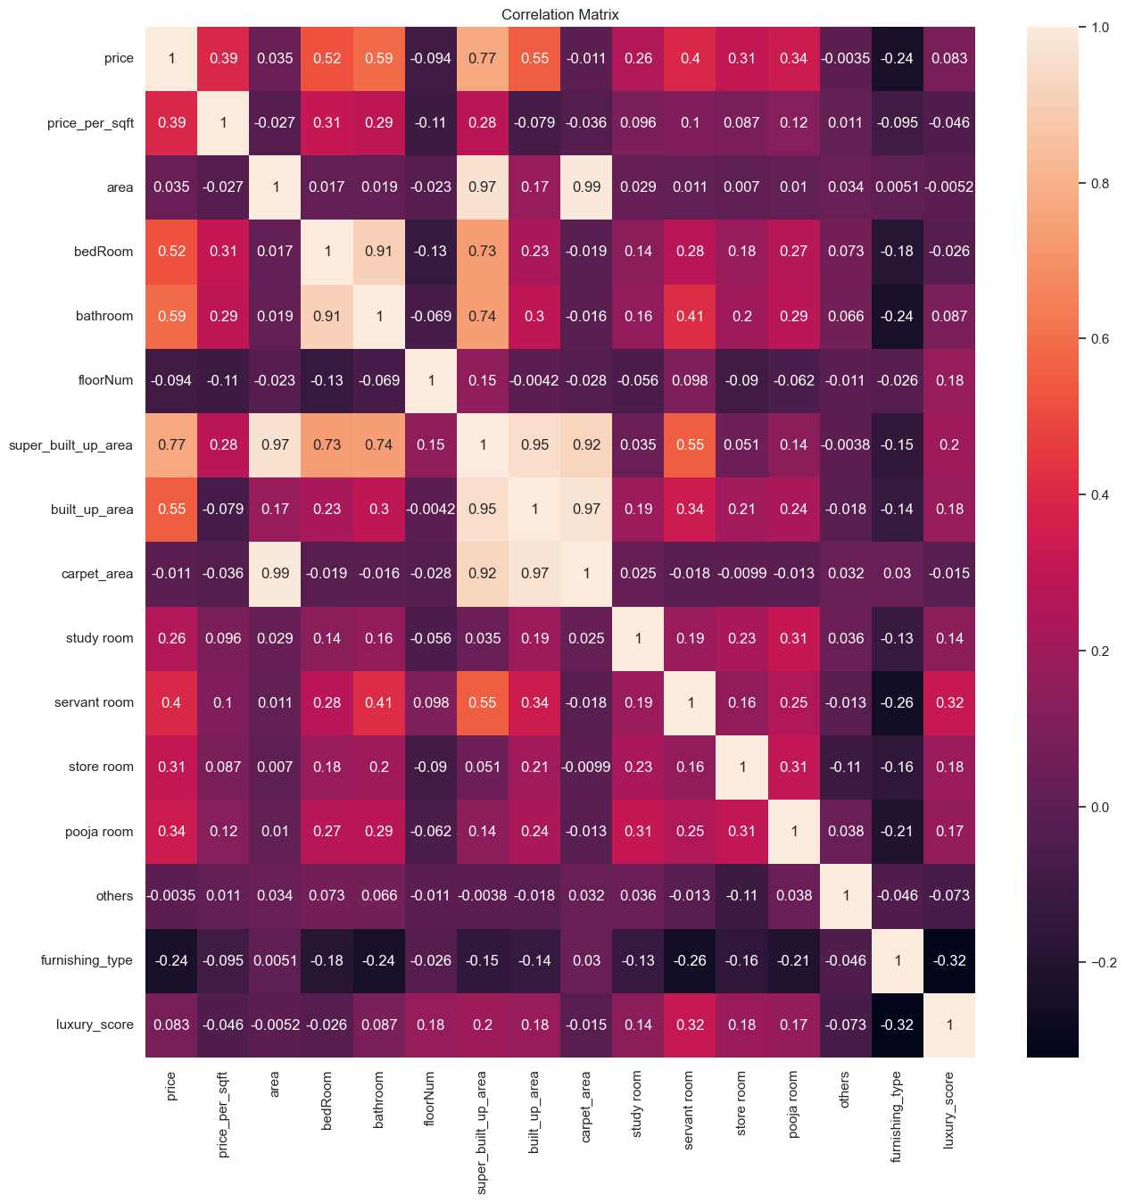
Multivariate Analysis

Slide 21
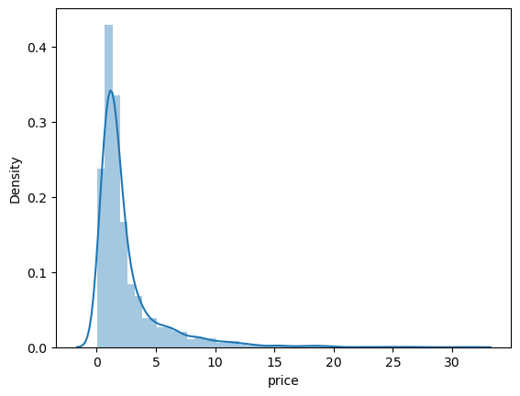
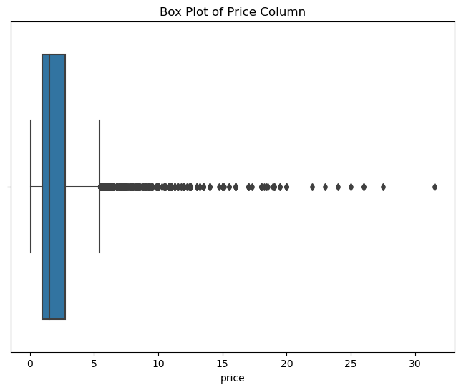
Outlier Detection

Slide 22
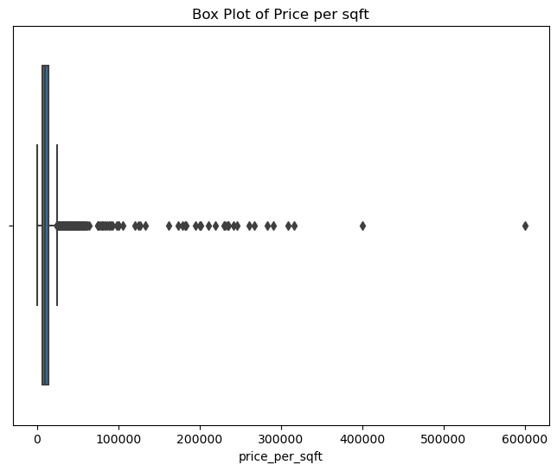
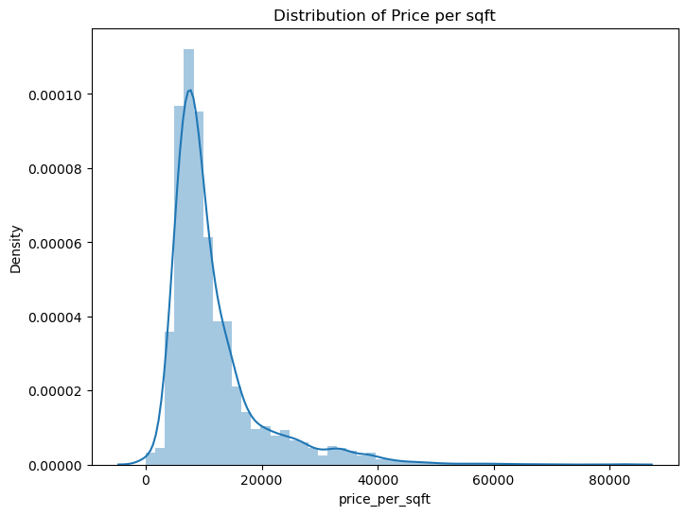
Outlier Detection

Slide 23
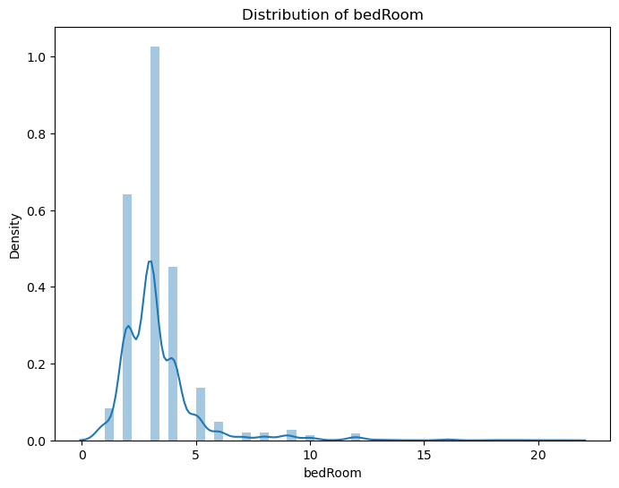
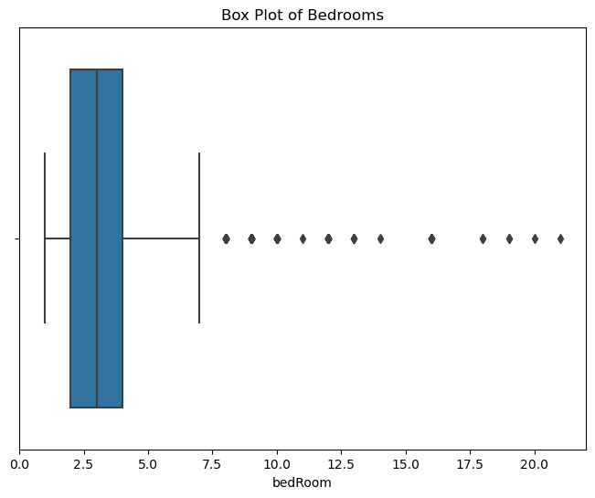
Outlier Detection

Slide 24
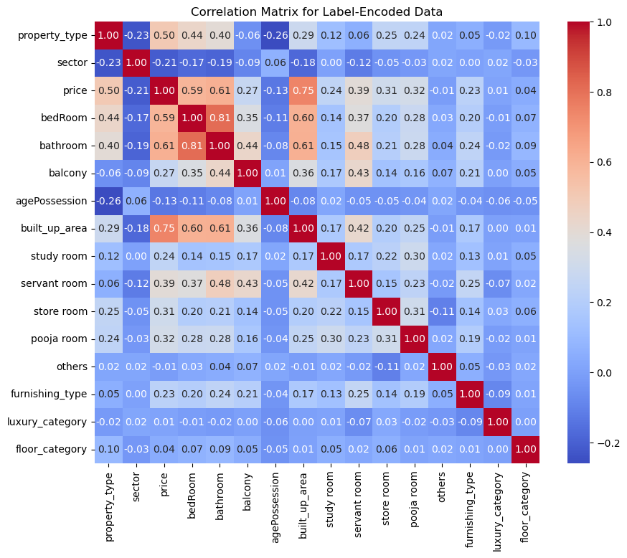
Feature Selection
Technique 1 - Correlation Analysis

Slide 25
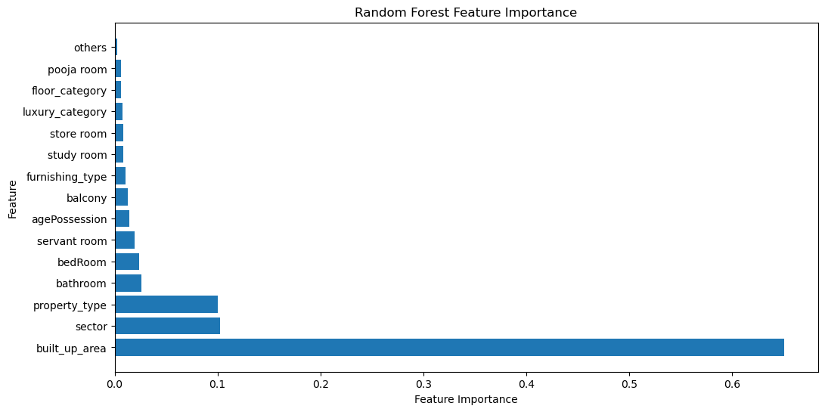
Feature Selection
Technique 2 - Random Forest Feature Importance

Slide 26
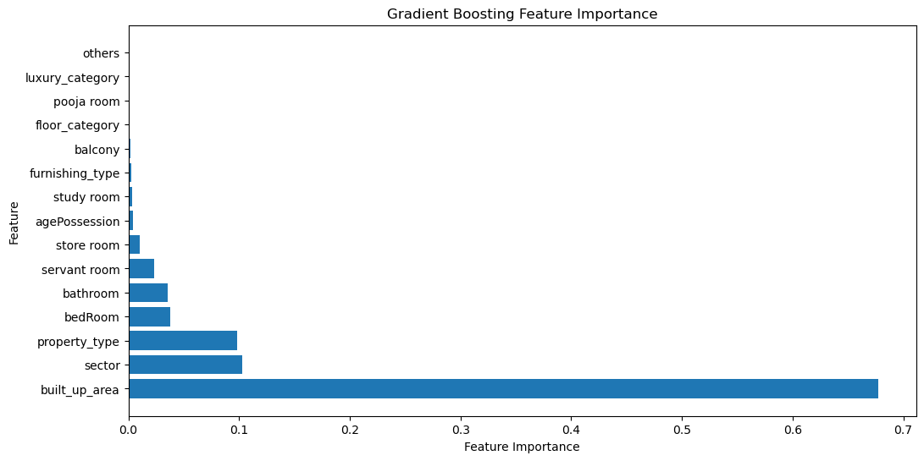
Feature Selection
Technique 3 - Gradient Boosting Feature Importances

Slide 27
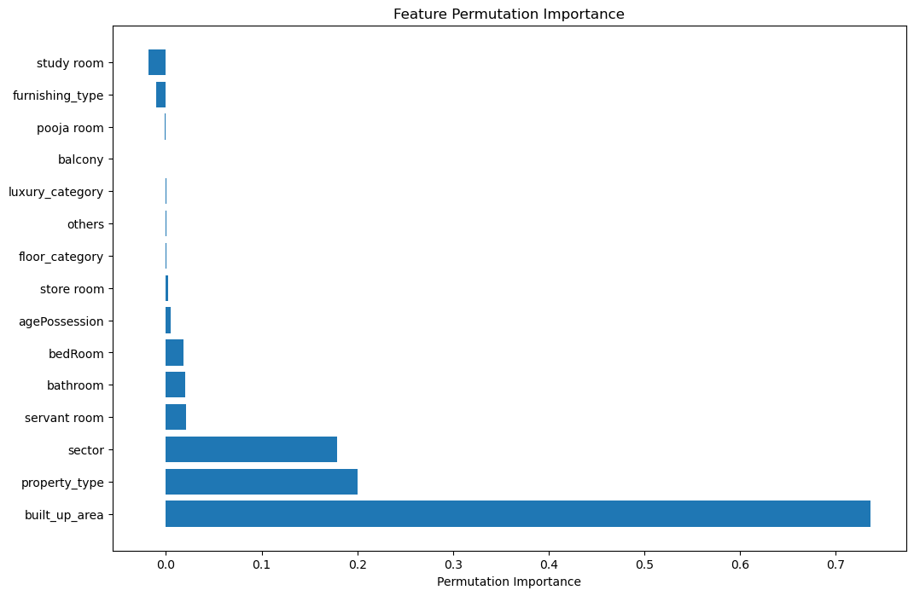
Feature Selection
Technique 4 - Permutation Importance

Slide 28
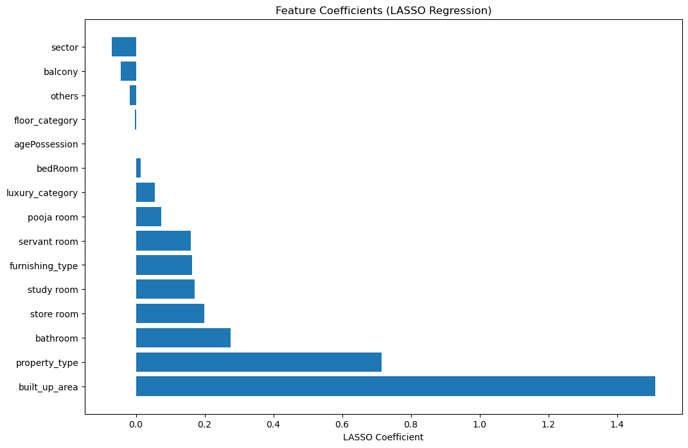
Feature Selection
Technique 5 - LASSO

Slide 29
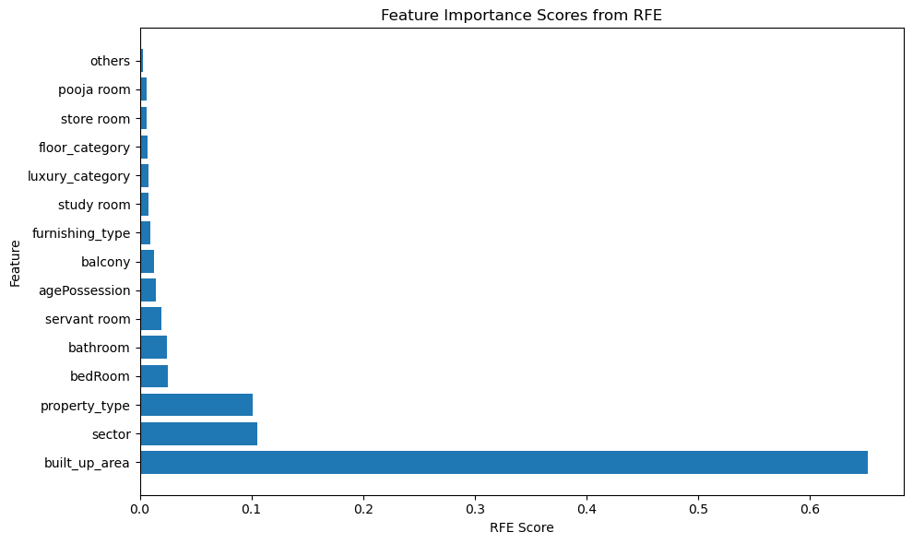
Feature Selection
Technique 6 – RFE(RandomForestRegressor)

Slide 30
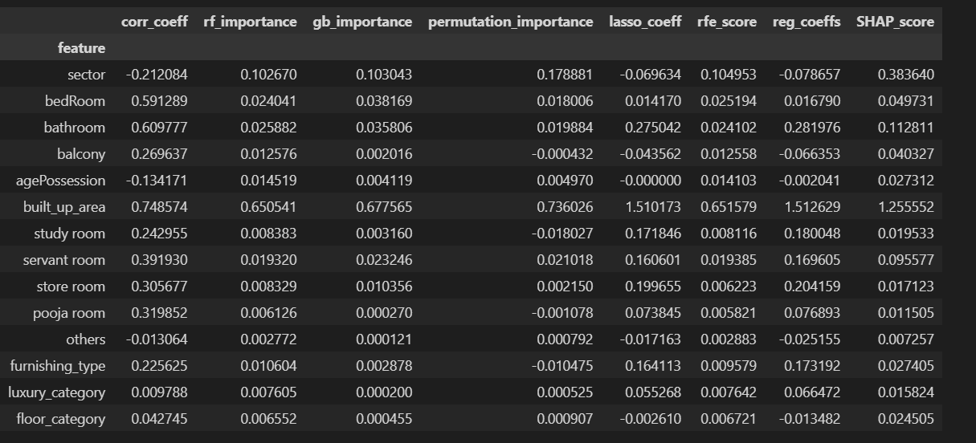
Feature Selection

Slide 31
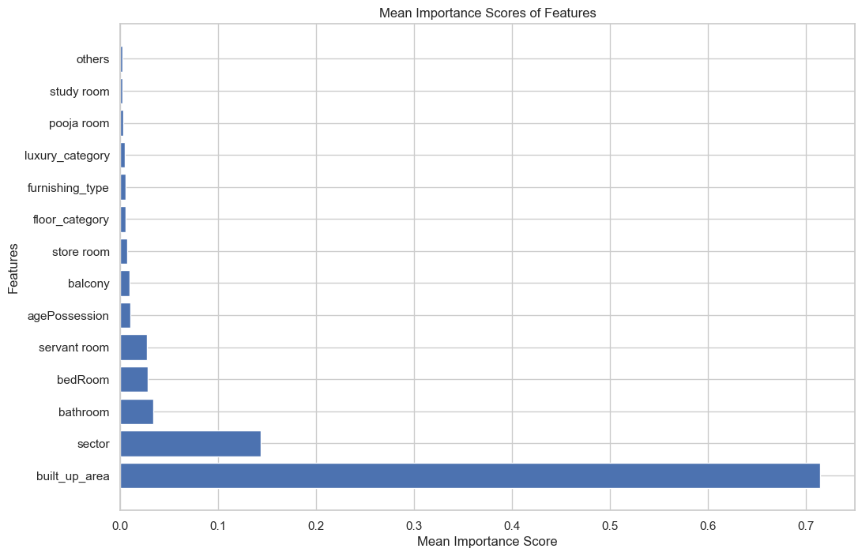
Feature Selection

Slide 32
Model Selection
Our model selection process involved exploring a diverse set of machine learning models, carefully chosen to address the intricacies of real estate analytics.
Explored Models:
Linear Regression
Support Vector Regressor (SVR):
Ridge Regression:
LASSO Regression:
Decision Tree Regressor:
Random Forest Regressor:
Extra Trees Regressor:
Gradient Boosting Regressor:
AdaBoost Regressor:
MLP Regressor:
XGBoost Regressor:

Slide 33
Evaluation Metrics:
R-squared (R²):
A measure of how well each model explains the variability in real estate prices.
Mean Absolute Error (MAE):
Representing the average absolute difference between predicted and actual real estate prices.

Slide 34
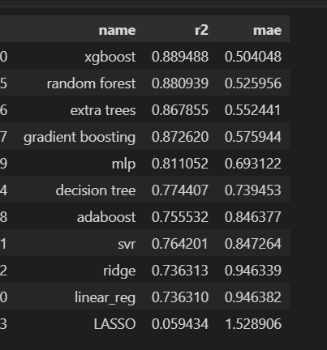
Ordinal Encoding

Slide 35
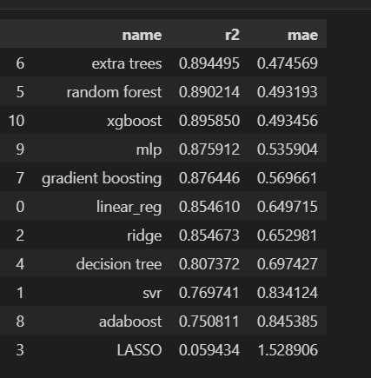
OneHotEncoding

Slide 36
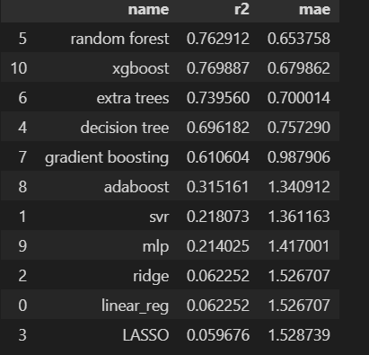
OneHotEncoding With PCA

Slide 37
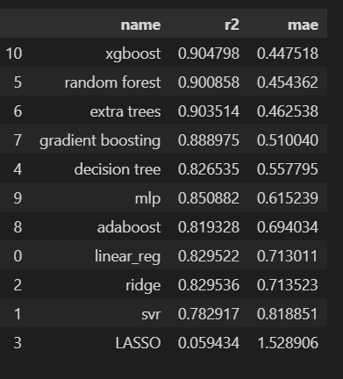
Target Encoder
Best Result

Slide 38
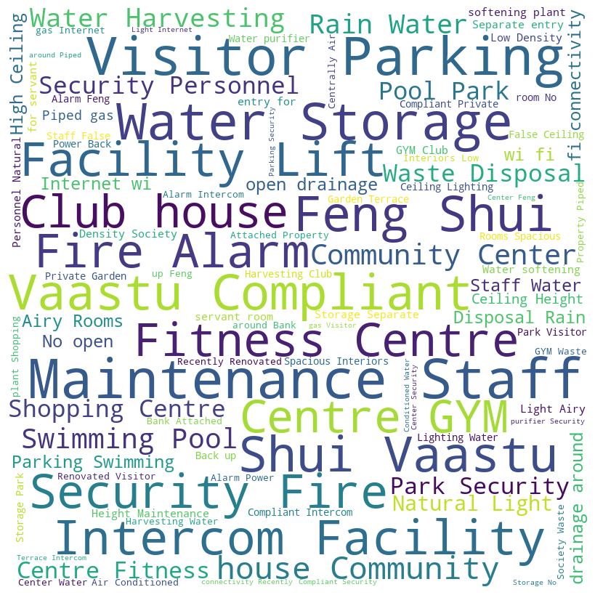
Building Analysis Module
Key Visualizations:
Word Cloud Analysis:
Offers a visual representation of
prominent features within the real
estate dataset.
Provides insights into common
attributes, guiding our understanding
of essential property features.

Slide 39
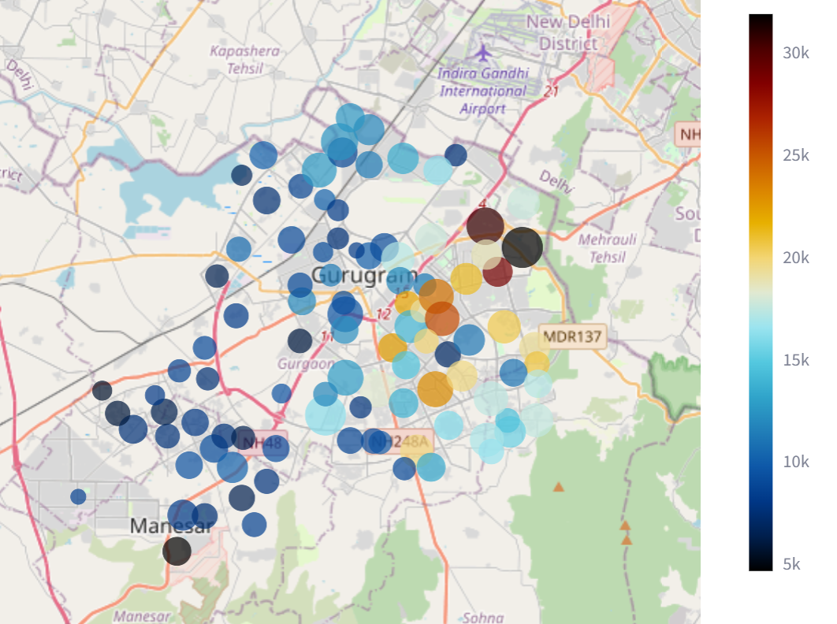
Building Analysis Module
Sector-wise Price Analysis:

Slide 40
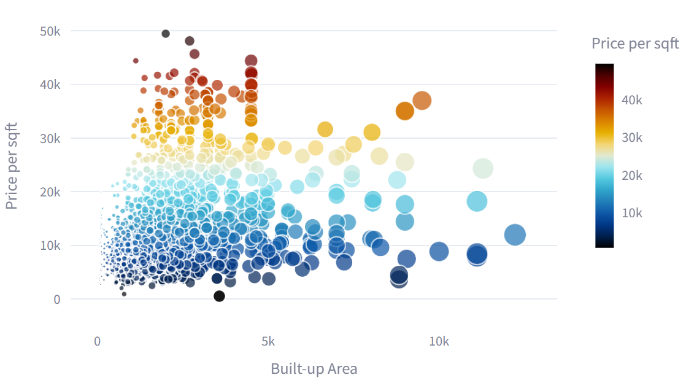
Building Analysis Module
Scatter Plots:
Explores relationships between property area, price, and other factors.
Different colors indicate various dimensions, facilitating a nuanced analysis.

Slide 41
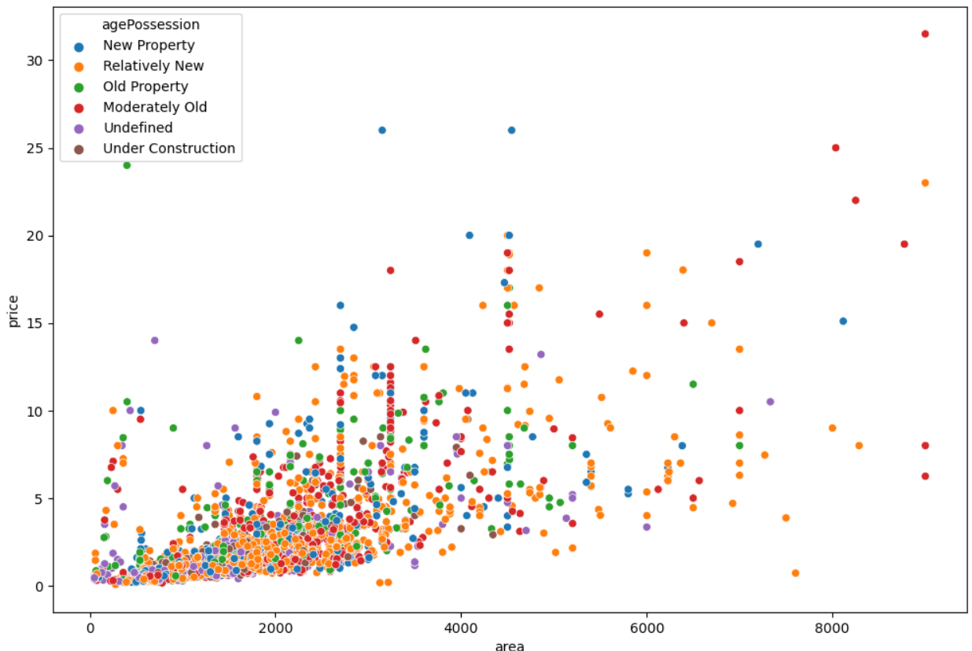
Building Analysis Module
Area Vs Price:

Slide 42
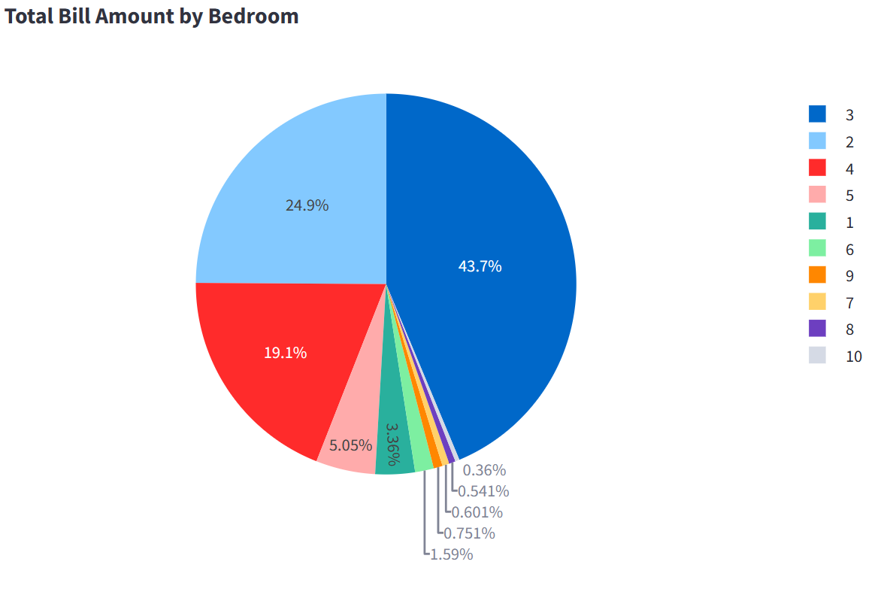
Building Analysis Module

Slide 43
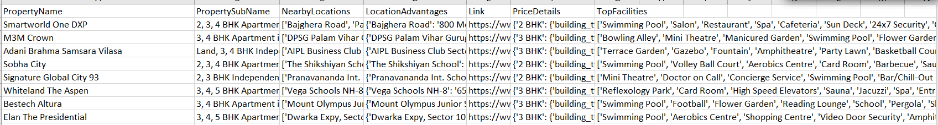
Building Recommendation System

Slide 44
Building Recommendation System
Our recommendation system is designed to provide users with personalized property suggestions based on their preferences.
Key Components:
TFIDF Vectorizer:
Utilizes Term Frequency-Inverse Document Frequency to analyze user preferences.
Transforms property descriptions into numerical vectors, capturing nuanced details for accurate recommendations.
Integration into Website:
Seamlessly incorporated into a user-friendly website for intuitive interaction.
Enhances accessibility and usability, catering to a diverse user base.

Slide 45
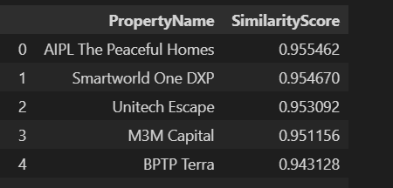
Building Recommendation System
Feature extraction through TFIDF vectorization.
Cosine similarity used to determine similarity scores.
Top 5 scores selected for presenting property suggestions.

Slide 46
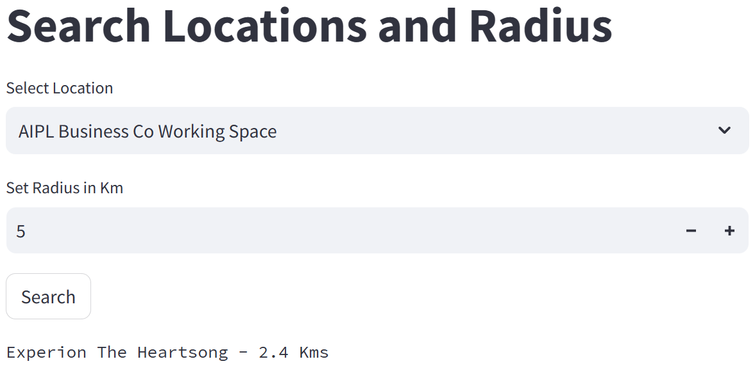
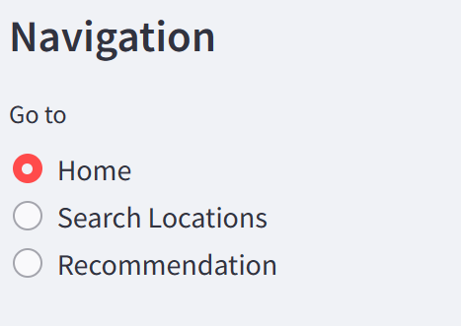
Building Recommendation System

Slide 47
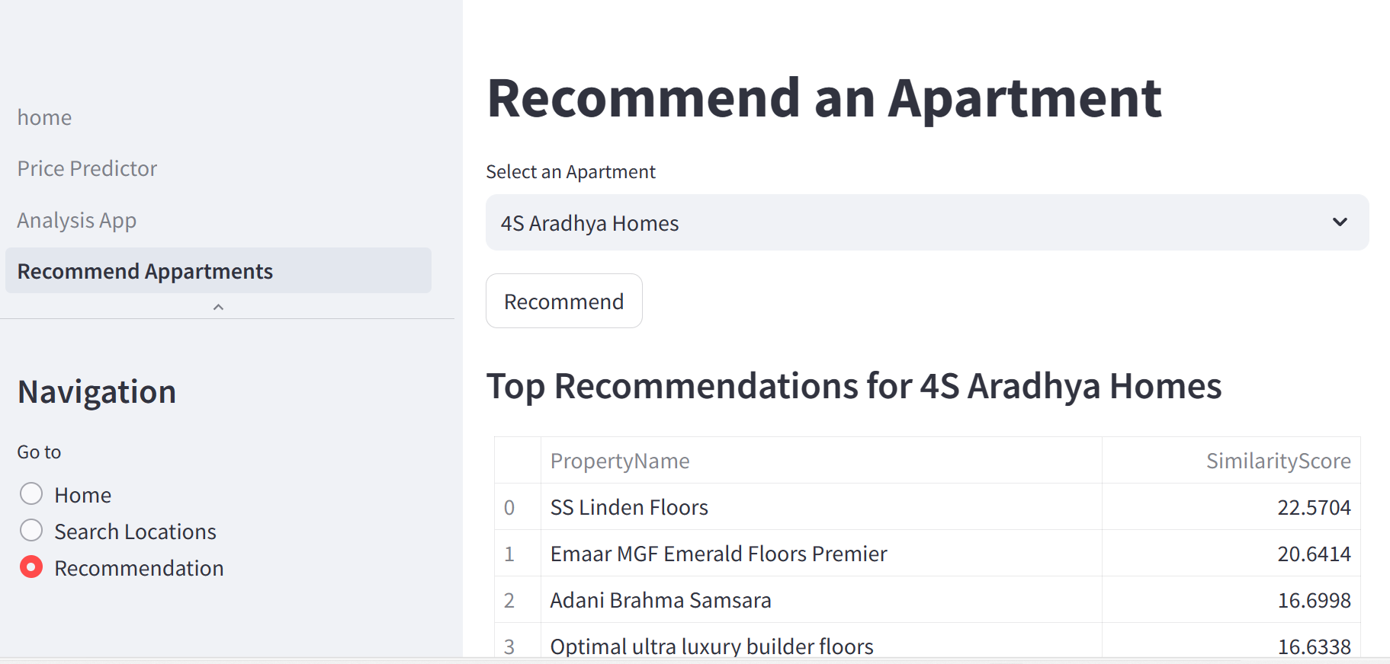
Building Recommendation System

Slide 48
Implementation in the Web
Practical Implementation:
The entire project seamlessly transitions into a user-friendly website, making real estate analytics accessible to a diverse audience.
Integration Highlights:
Machine Learning Models:
Rigorously integrated diverse machine learning models.
Models work collectively to provide accurate real estate price predictions.
Recommendation System:
Incorporated the recommendation system, driven by the TFIDF Vectorizer.
Enhances user engagement by providing personalized property suggestions.
Building Analysis Module

Slide 49
Conclusion
Project Achievements:
The project has successfully addressed challenges, including a messy dataset, missing values, and complex real estate dynamics.
Quality of Results:
Rigorous evaluations validate the robustness of our Real Estate Price Prediction and Recommendation System.
XGBoost consistently emerges as a top performer, achieving a notable score of 0.9028.
The recommendation system adds sophistication, enhancing user engagement and satisfaction.

Slide 50
Future Directions:
Promising avenues for future exploration and refinement include:
Deep Learning Approaches:
Exploring the application of deep learning techniques for enhanced predictive modeling.
Dynamic Recommendation Models:
Incorporating dynamic algorithms adapting to changing user preferences over time.
User Feedback Integration:
Continuous improvement by incorporating user feedback mechanisms.

Slide 51
